Slide 1

DEPARTMENT OF COMPUTER ENGINEERING
Plant Disease Detection and Treatment (Group no: 10)
Student name : Janavi Kharat Roll no: 83 Division:B
Student name : Sanket Naikwadi Roll no: 116 Division:B
Student name : Aman Pandey Roll no: 128 Division:B
Student name : Sayali Nikam Roll no: 120 Division:B
Under the Guidance of : Prof.Varsha Wangikar

Slide 2
Problem statement :
Human society would need to raise food production by an estimated 70% by 2050 to feed a population of more than 9 billion people. Infectious illnesses currently limit potential production by 40% on average, with many farmers in the developing countries facing yield losses of up to 100%.
The broad availability of smartphones among farmers worldwide has the potential to transform cellphones into a valuable tool for those farmers.
This project can be used by farmers to diagnose early if their plants are suffering from any diseases or not.
Plant Disease Detection and Treatment

Slide 3
Objective :
The main objective is to identify the plant diseases using CNN model by image processing with ResNet .
After identification of the disease, the model will give information about disease also treatment which needs to be done as a cure.
Model will fetch data from datasets and display it to the user.
Hence, we can limit pest attacks by utilizing appropriate pesticides and treatments.

Slide 4
Scope :
We will build a convolutional neural network (CNN Model) that can predict whether or not a plant is infected.
We will use different layers and other hyperparameters for building, training and testing.
This model is mainly built using TensorFlow and Keras.
This system will assist farmers by facilitating the rapid identification and treatment of plant diseases, as well as assisting them in making informed decisions while using chemical pesticides.
Plant Disease Detection and Treatment

Slide 5
Literature Survey
Sr No. | Author | Research Paper | Outcomes | Year
1. | Vinod Kumar, Hritik Arora | ResNet-based approach for Detection and Classification of Plant Leaf Diseases | Demonstrated the feasibility of using residual networks (ResNet) to classify plant diseases.
2. | Ashwini C | Plant Disease Detection by image pre-processing | Linear & Non Linear SVM. Feature Extraction with Image greysccaling, edge detetction, image sharpening etc.
3. | A Kulkarni | Applying image processing technique to detect plant diseases | Artificial Neural network (ANN) & Gabol Filter for feature extraction which is used in texture analysis.

Slide 6
4. | Prof. Sanjay, B. Dhaygude | Agricultural plant Leaf Disease Detection Using Image | Vision-based detection algorithm, Conversion of RGB to HSV, Masking of Pixels, Texture Statistics.
5. | Emaneul Cortes | Plant disease detection using CNN and GAN | Generative Adversarial networks & Convolutional Neural Network

Slide 7
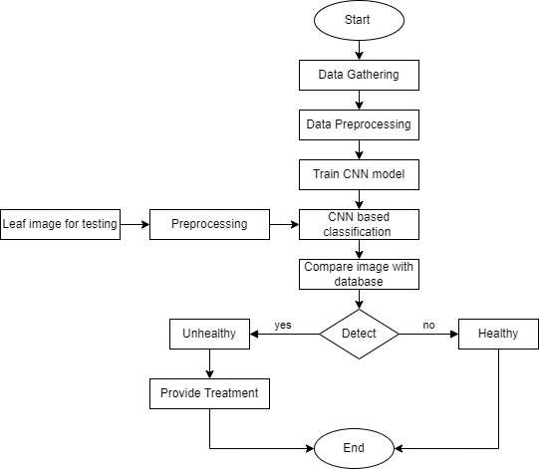
Architecture Diagram

Slide 8
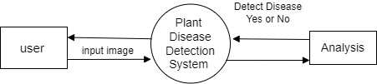
DFD level 0 :

Slide 9
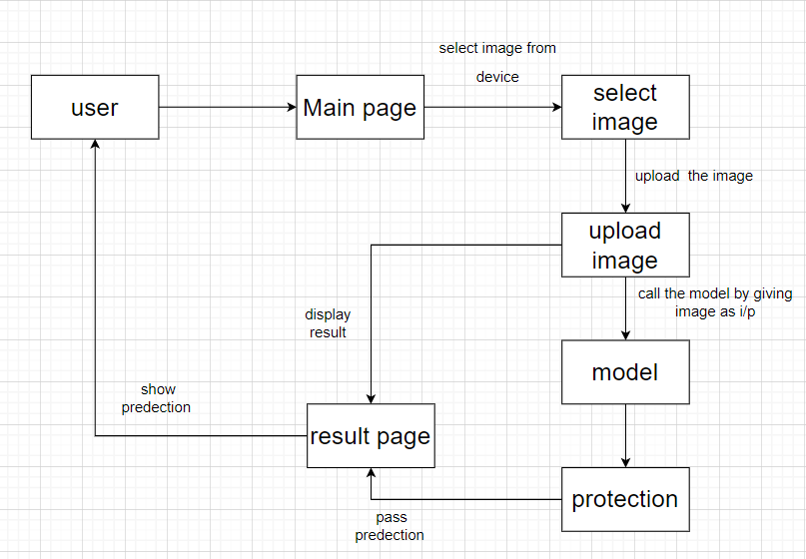
DFD level 1:

Slide 10
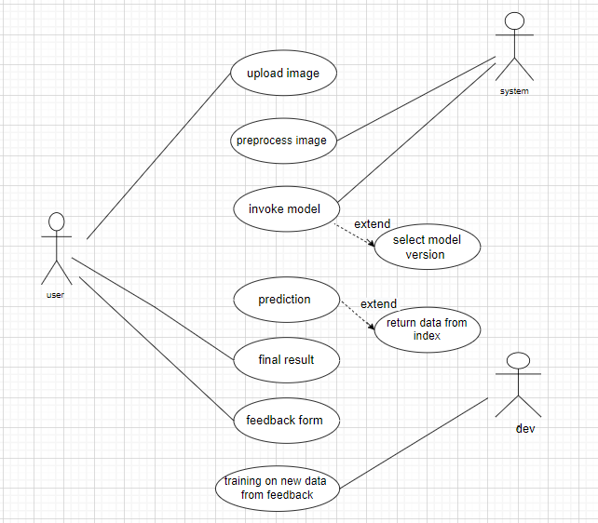
Use case diagram :

Slide 11
Implementation Methodology:
Image Dataset Acquisition: The Dataset was taken from Kaggle of Plant Village dataset. In this data-set, 14 different classes of plant leaf and Background images are available. The data-set containing 1,44,134 images. There is a total of 38 Classes that we have to predict using the CNN Model.
Pre-processing of Images: Transforms are used for Data Augmentation like cropping the image, resize the image, convert the image to tensor, rotate the image, and many more. Transforms work as a filter for all images.
Train and Test Split: Split the data into train, test and validation data.
Model Creation: We use a convolutional neural network for model creation. We also specified filter size for the Conv layer and Pool layer and the shape on each layer.

Slide 12
Pseudo code
class ResNet9(nn.Module):
def __init__(self, in_channels, num_diseases):
super().__init__()
self.conv1 = ConvBlock(in_channels, 64)
self.conv2 = ConvBlock(64, 128, pool=True)
self.res1 = nn.Sequential(ConvBlock(128, 128), ConvBlock(128, 128))
self.conv3 = ConvBlock(128, 256, pool=True)
self.conv4 = ConvBlock(256, 512, pool=True)
self.res2 = nn.Sequential(ConvBlock(512, 512), ConvBlock(512, 512))
self.classifier = nn.Sequential(nn.MaxPool2d(4),
nn.Flatten(),
nn.Linear(512, num_diseases))
def forward(self, xb):
use_cuda = False
out = self.conv1(xb)
out = self.conv2(out)
out = self.res1(out) + out
out = self.conv3(out)
out = self.conv4(out)
out = self.res2(out) + out
out = self.classifier(out)
return out

Slide 13
Technology :
Frontend: Javascript, Html , CSS , ReactJS
Backend: Python,FastAPI
Machine Learning:- Tensorflow , Keras ,pytorch
(What is keras & tensorflow?)
TensorFlow is an open-sourced end-to-end platform, a library for multiple machine learning tasks, while Keras is a high-level neural network library that runs on top of TensorFlow.)
Plant Disease Detection and Treatment

Slide 14
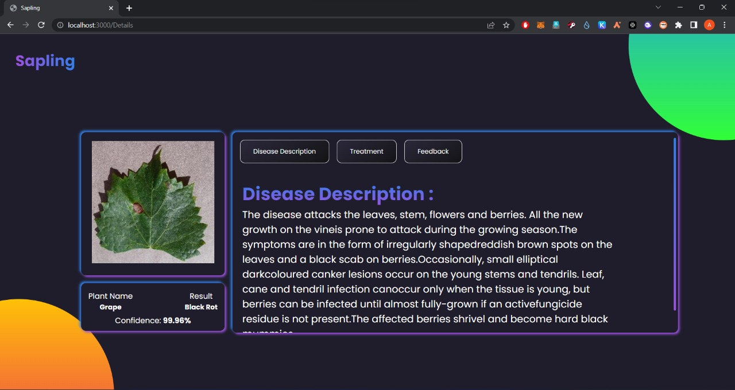
Results

Slide 15
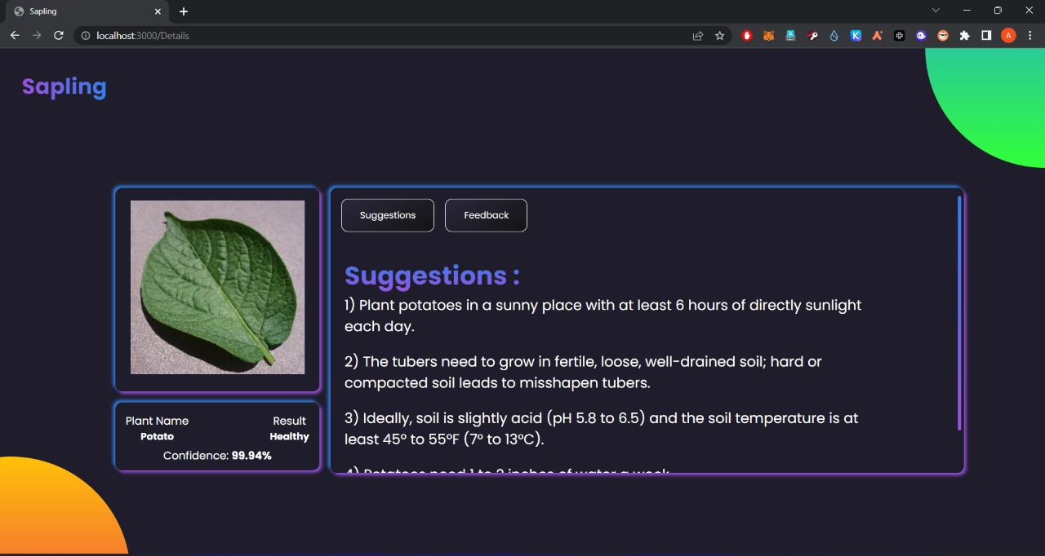

Slide 16
References :
[1] V. Kumar, H. Arora, Harsh and J. Sisodia, "ResNet-based approach for Detection and Classification of Plant Leaf Diseases," 2020 International Conference on Electronics and Sustainable Communication Systems (ICESC), 2020, pp. 495-502, doi: 10.1109/ICESC48915.2020.9155585.
[2] S. D. Khirade and A. B. Patil, "Plant Disease Detection Using Image Processing," 2015 International Conference on Computing Communication Control and Automation, 2015, pp. 768-771, doi: 10.1109/ICCUBEA.2015.153.
[3] L. Li, S. Zhang and B. Wang, "Plant Disease Detection and Classification by Deep Learning—A Review," in IEEE Access, vol. 9, pp. 56683-56698, 2021, doi: 10.1109/ACCESS.2021.3069646.
[4] R. Kaur and S. S. Kang, "An enhancement in classifier support vector machine to improve plant disease detection," 2015 IEEE 3rd International Conference on MOOCs, Innovation and Technology in Education (MITE), 2015, pp. 135-140, doi: 10.1109/MITE.2015.7375303.
[5] R. Gandhi, S. Nimbalkar, N. Yelamanchili and S. Ponkshe, "Plant disease detection using CNNs and GANs as an augmentative approach," 2018 IEEE International Conference on Innovative Research and Development (ICIRD), 2018, pp. 1-5, doi: 10.1109/ICIRD.2018.8376321.
[6] S. S. Kumar and B. K. Raghavendra, "Diseases Detection of Various Plant Leaf Using Image Processing Techniques: A Review," 2019 5th International Conference on Advanced Computing & Communication Systems (ICACCS), 2019, pp. 313-316, doi: 10.1109/ICACCS.2019.8728325.
Plant Disease Detection and Treatment

